Slide 1
ANLY 560 Functional Programming Methods for Analytics
Course Introduction
Zi (Bennie) Yang, PhD

Slide 2
Lesson outcomes
Understand course expectations
Understand overall flow of semester
Describe key programming paradigms such as imperative, functional, data-driven, and object-oriented
Explain the advantages and disadvantages of scripted and compiled languages
Describe each of the 3 control structures: Sequence, selection, and iteration
Identify control structures in various programming languages
Discuss key aspects of structured, unstructured, and tidy data

Slide 3
Flow of the semester
Programming concepts
Roughly 4 blocks based programming paradigms
Languages
Control structures
Data
Computing environment
Hardware & Software
Software version control

Slide 4
Flow of the semester (con’t)
Paradigm discussion
Declarative
Imperative
Object oriented
Event driven
2 homework assignments, 3 labs and 2 exams

Slide 5
Flow of the semester
Week 1: Overview of paradigms in general and the four to be discussed in class
Week 2: GitHub software repository
Week 3: Declarative programming 1: concepts => SQL & Python
Week 4: Declarative programming 2: Data applications – accessing MySQL data base from Python
Week 5: Imperative programming 1: concepts – using Java
Week 6：Imperative programming 2: Java/Python comparison + data wrangling application 1 using Python
Week 7: Imperative programming 3: Data wrangling application 2 + data visualization using Python
Week 8: Imperative programming 4: Data application -> Web scraping – concept & application
Week 9： Exam 1
Week 10: Object orientation 1: concepts + Java implementation
Week 11: Object orientation 2: comparison of implementations Java vs. Python
Week 12: Object orientation 3: Data application – accessing a database base using OO concepts in Java vs Python
Week 13: Event-based programming: Concept and implementation in Java & Python
Week 14: Exam 2

Slide 6
Programming paradigms
A way to classify programming languages based on their features.
Languages can be classified into multiple paradigms.
Some paradigms are concerned mainly with implications for the execution model of the language, such as allowing side effects, or whether the sequence of operations is defined by the execution model.
Other paradigms are concerned mainly with the way that code is organized, such as grouping a code into units along with the state that is modified by the code. Yet others are concerned mainly with the style of syntax and grammar.

Slide 7
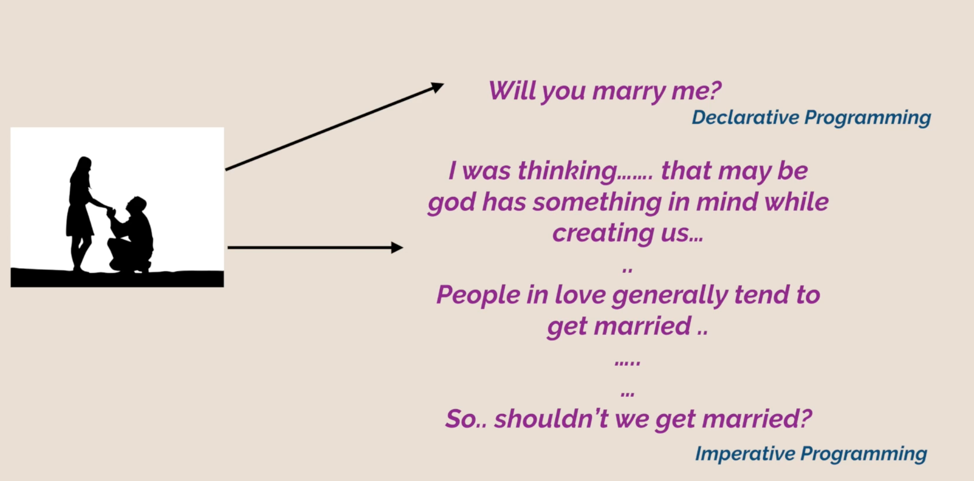
Programming paradigms (con’t)

Slide 8
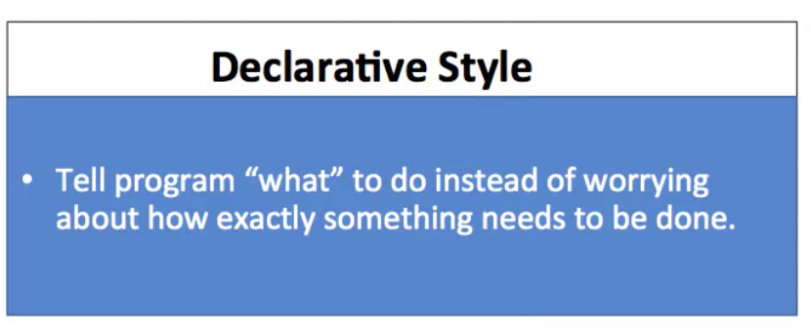
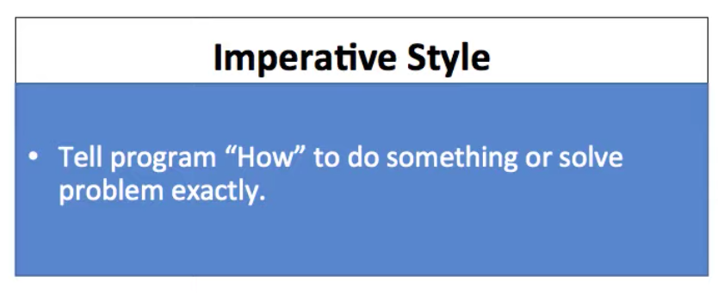
Programming paradigms (con’t)
Declarative
Description - Defines program logic, but not detailed control flow
Main traits - Fourth-generation languages, spreadsheets, report program generators
Examples - SQL, regular expressions, CSS, Prolog, OWL, SPARQL
Imperative
Description
Programs as statements that directly change computed state (datafields)
A style of imperative programming with more logical program structure
Derived from structured programming, based on the concept of modular programming or the procedure call
Main traits
Direct assignments, common data structures, global variables
Structograms, indentation, no or limited use of goto statements
Local variables, sequence, selection, iteration, and modularization
Examples - C, C++, Java, Python

Slide 9
Programming paradigms (con’t)
Object oriented
Description - Treats data-fields as objects manipulated through predefined methods only
Main traits - Objects, methods, message passing, information hiding, data abstraction, encapsulation, polymorphism, inheritance, serialization-marshalling
Examples - Common Lisp, C++, C#, Eiffel, Java, PHP, Python, Ruby, Scala
Event driven
Description – flow of the program is determined by events such as user mouse clicks, sensor outputs, messages from other programs, etc.
Main traits - A single main loop that listens for events, programmer develops responses to potential events
Examples - C++, C#, Java, Python, Ruby, JavaScript

Slide 10
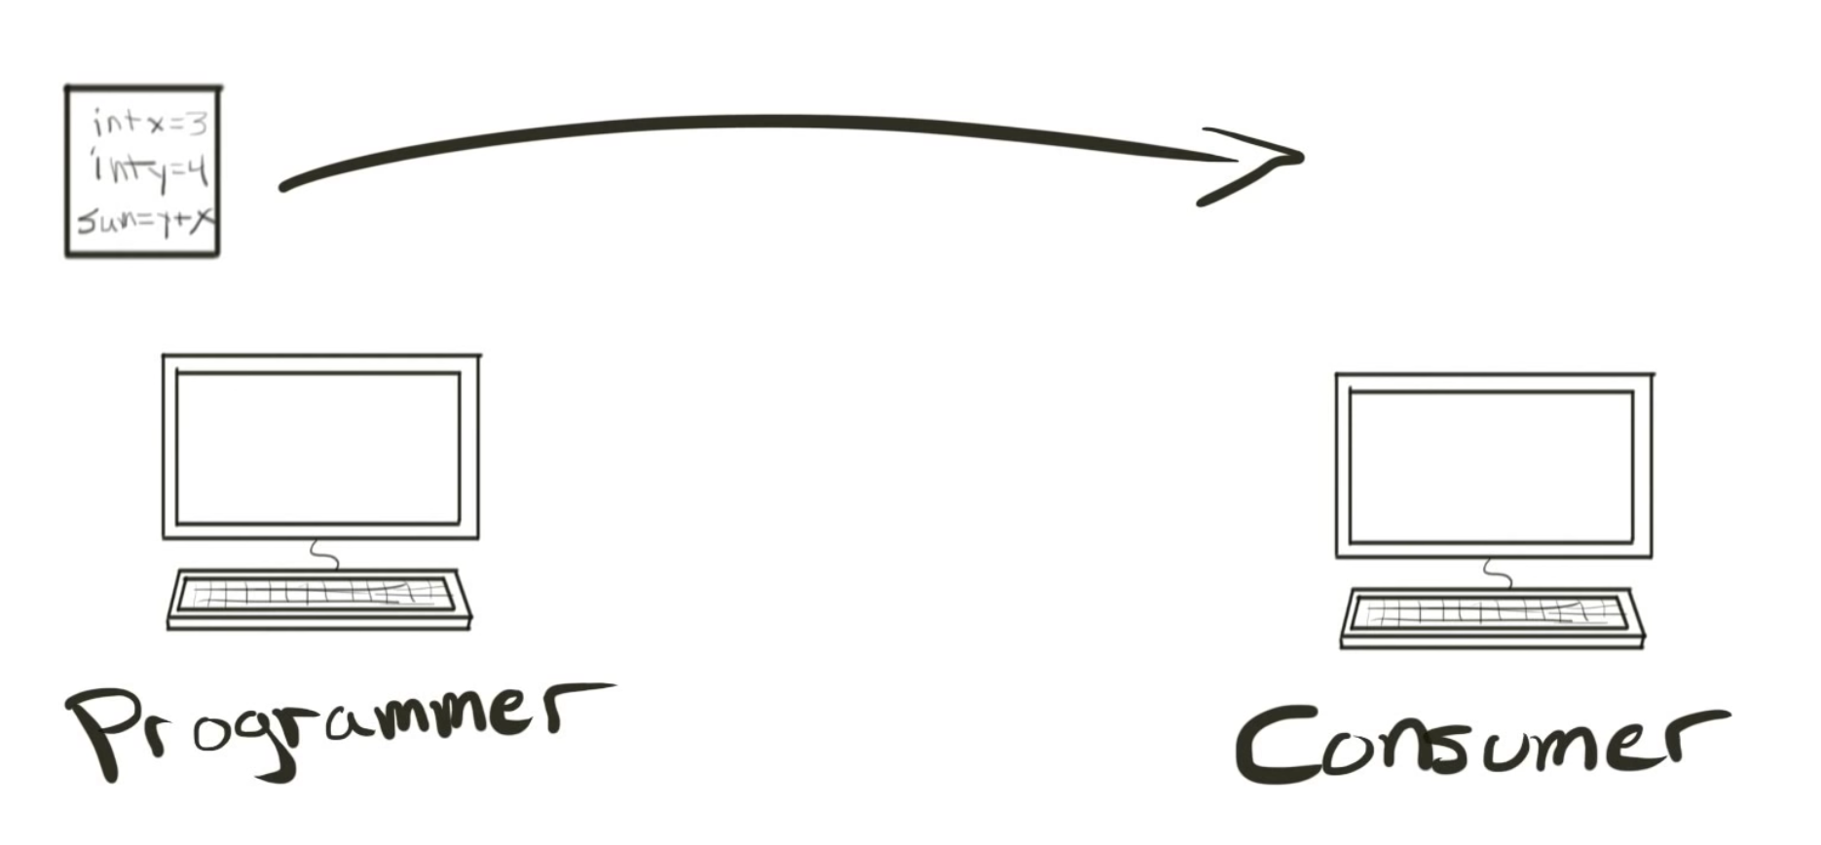
Scripted vs compiled languages

Slide 11
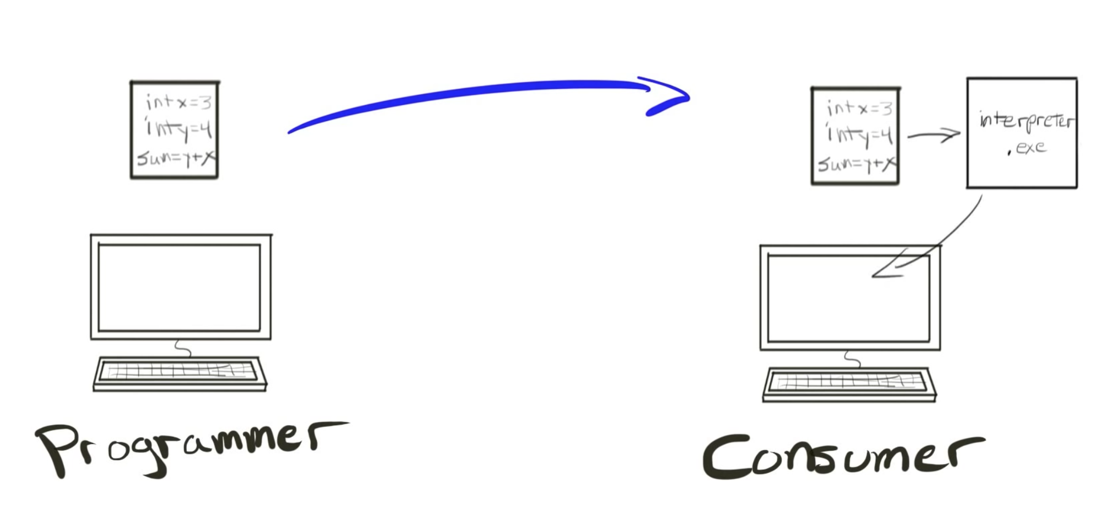
Scripted vs compiled languages
Scripted language
An interpreted language
Most of its implementations execute instructions directly and freely, without previously compiling a program into machine-language instructions.
The interpreter executes the program directly, translating each statement into a sequence of one or more subroutines already compiled into machine code.

Slide 12
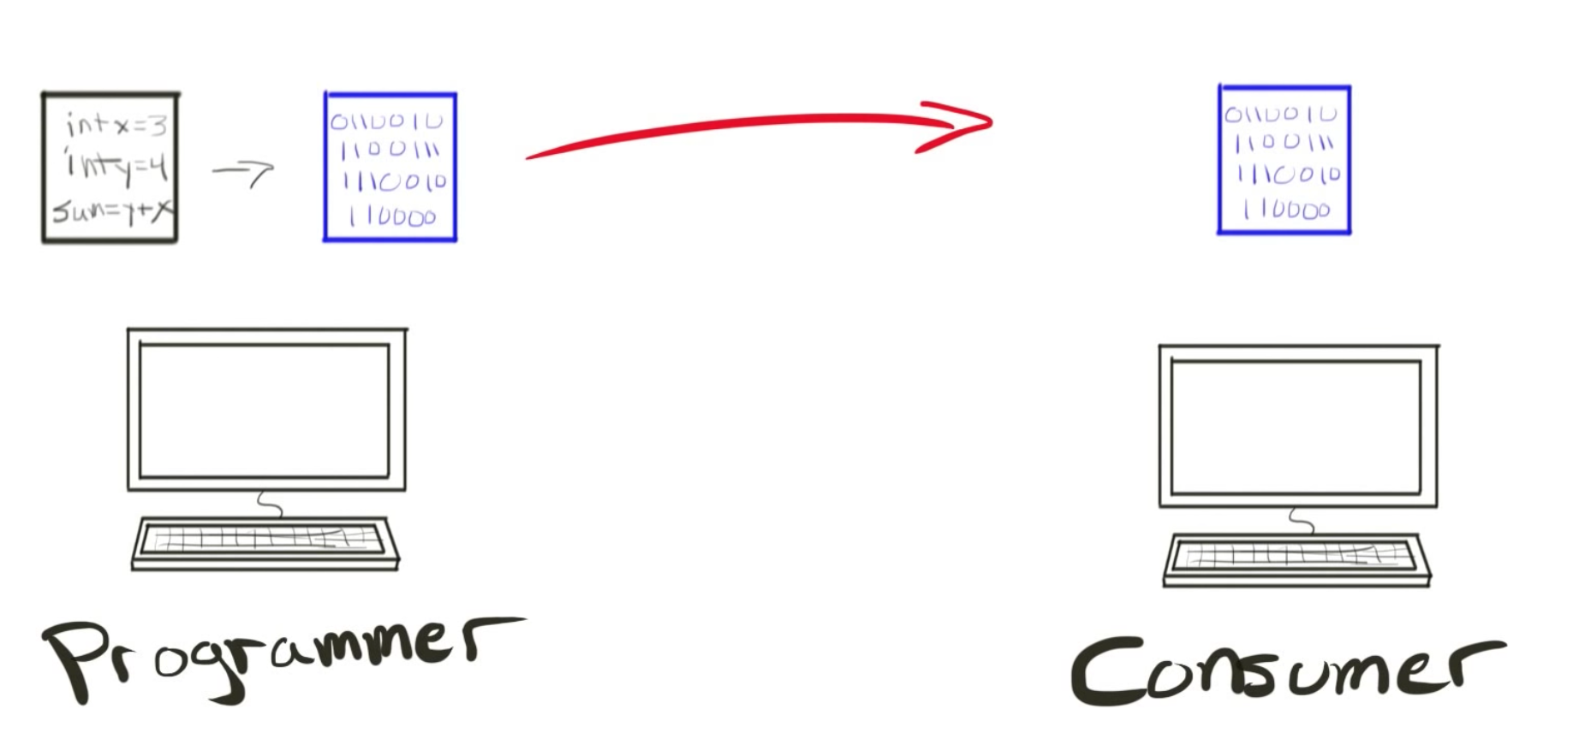
Scripted vs compiled languages (con’t)
Compiled language
a programming language whose implementations are typically compilers (translators that generate machine code from source code), and not interpreters

Slide 13
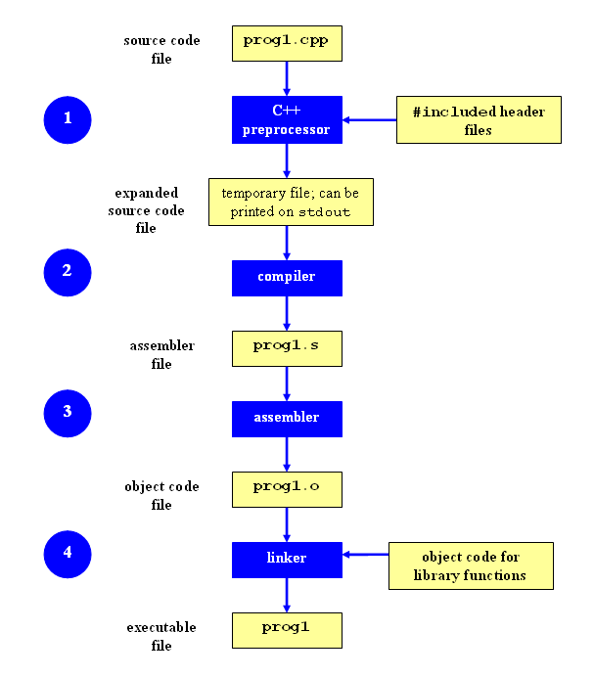
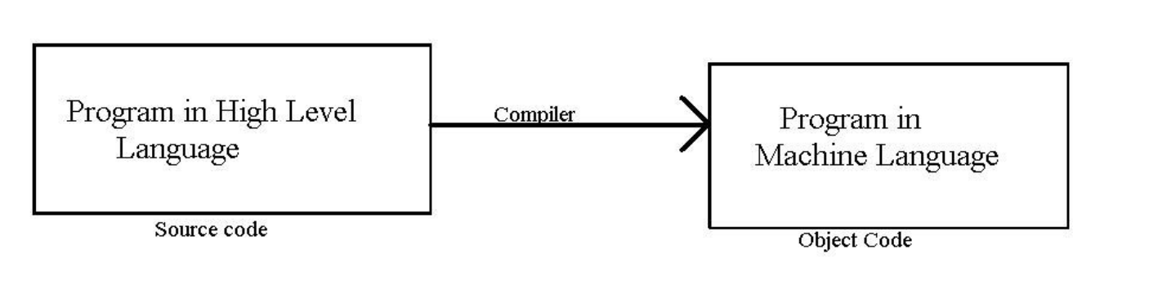
Scripted vs compiled languages (con’t)
Compilation process
Preprocessing
Compilation
Assembly
Linking
Compilation process - https://www.calleerlandsson.com/the-four-stages-of-compiling-a-c-program/#preprocessing

Slide 14
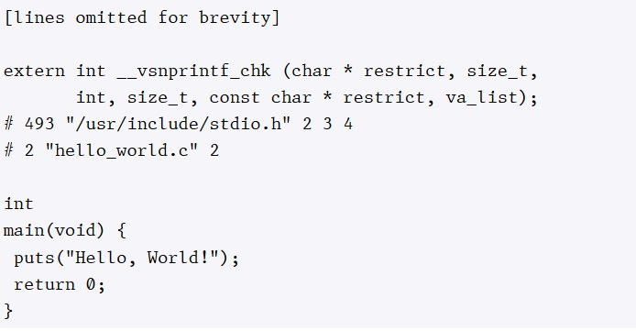
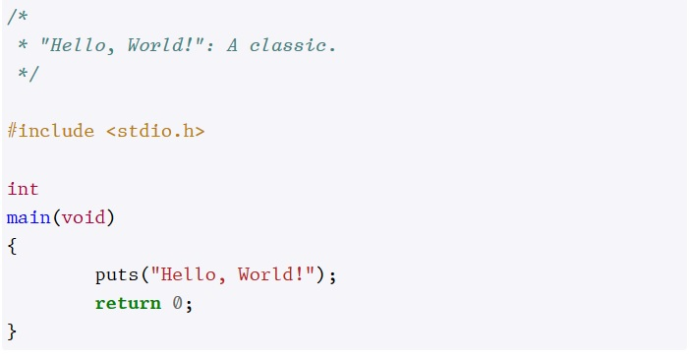
Preprocessing

Slide 15
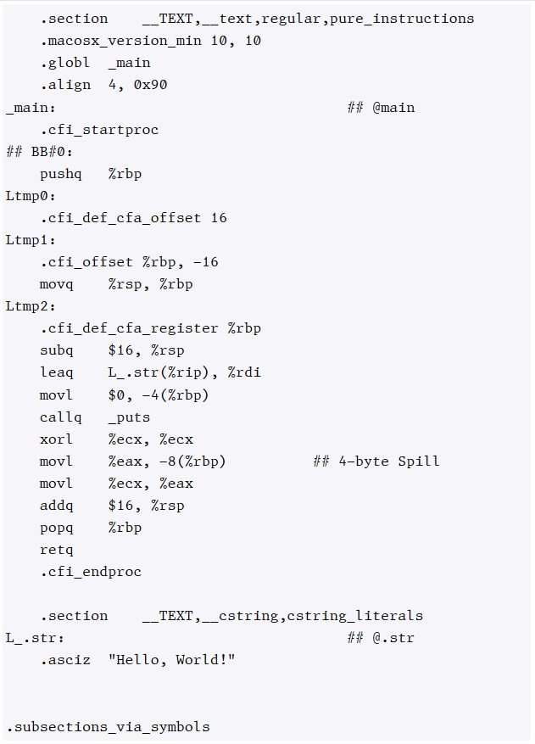
Compilation

Slide 16
Assembly & Linking

Slide 17
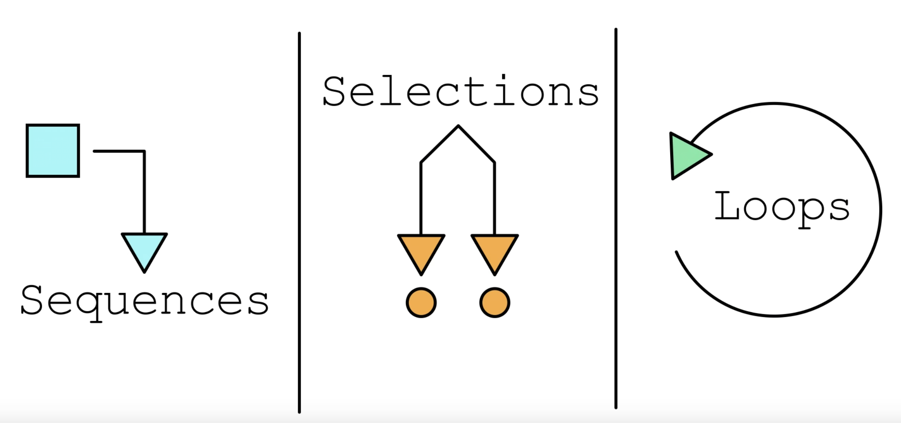
Program control structures
Sequence, Selection, Iteration
An algorithm can be developed to solve any problem by using only these 3 program control structures
You will find these structures implemented in many languages
Being able to identify them across languages significantly simplifies the task of learning new languages

Slide 18
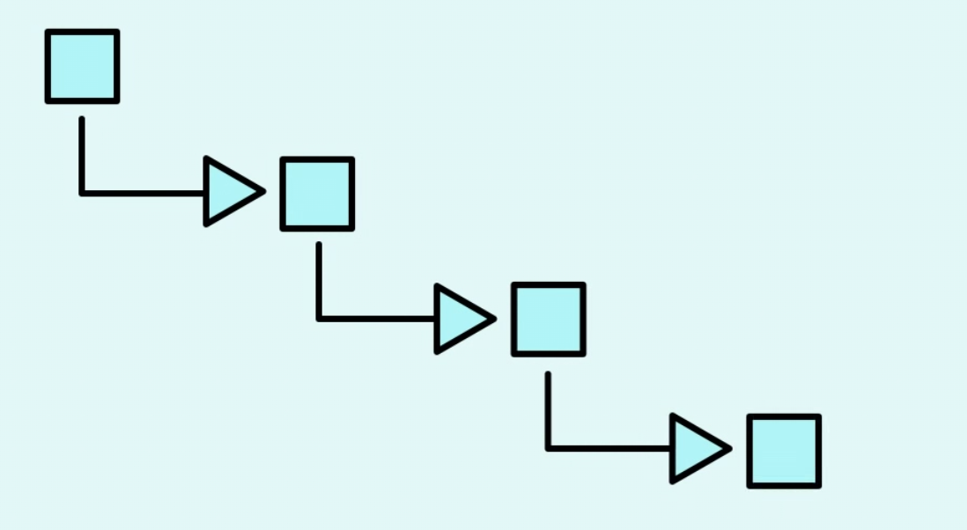

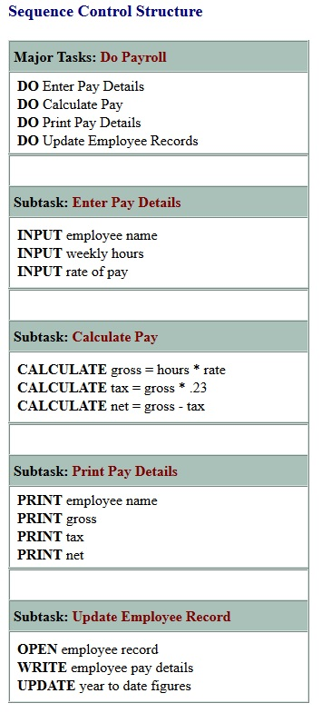
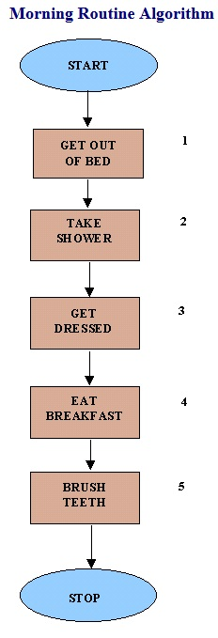

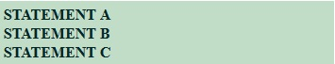
Sequence

Slide 19

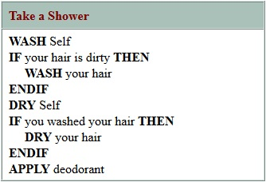
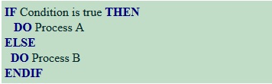
Selection

Slide 20

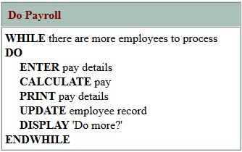
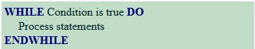
Iteration/Loop

Slide 21
Data
Structured vs Unstructured
Structured data: Structured data is data that has a prescribed format, e.g. tabular data consisting of rows and columns of numerical data, dates, product prices, etc
Unstructured data: data that is not in a prescribed format, eg: media, text file,
“Tidy” Data
Canvas Module 1: Wickham_tidy-data.pdf

Slide 22
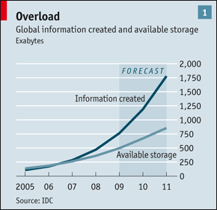
Data
Sources of Data:
https://www.data.gov/
http://data.worldbank.org/
http://data.un.org/
http://mlr.cs.umass.edu/ml/index.html
http://www.kdnuggets.com/datasets/index.html
http://www.statsci.org/datasets.html
And many, many more
This figure is from a 2010 article in The Economist. Retrieved online from: http://www.economist.com/node/15557443 May 9, 2017

Slide 23
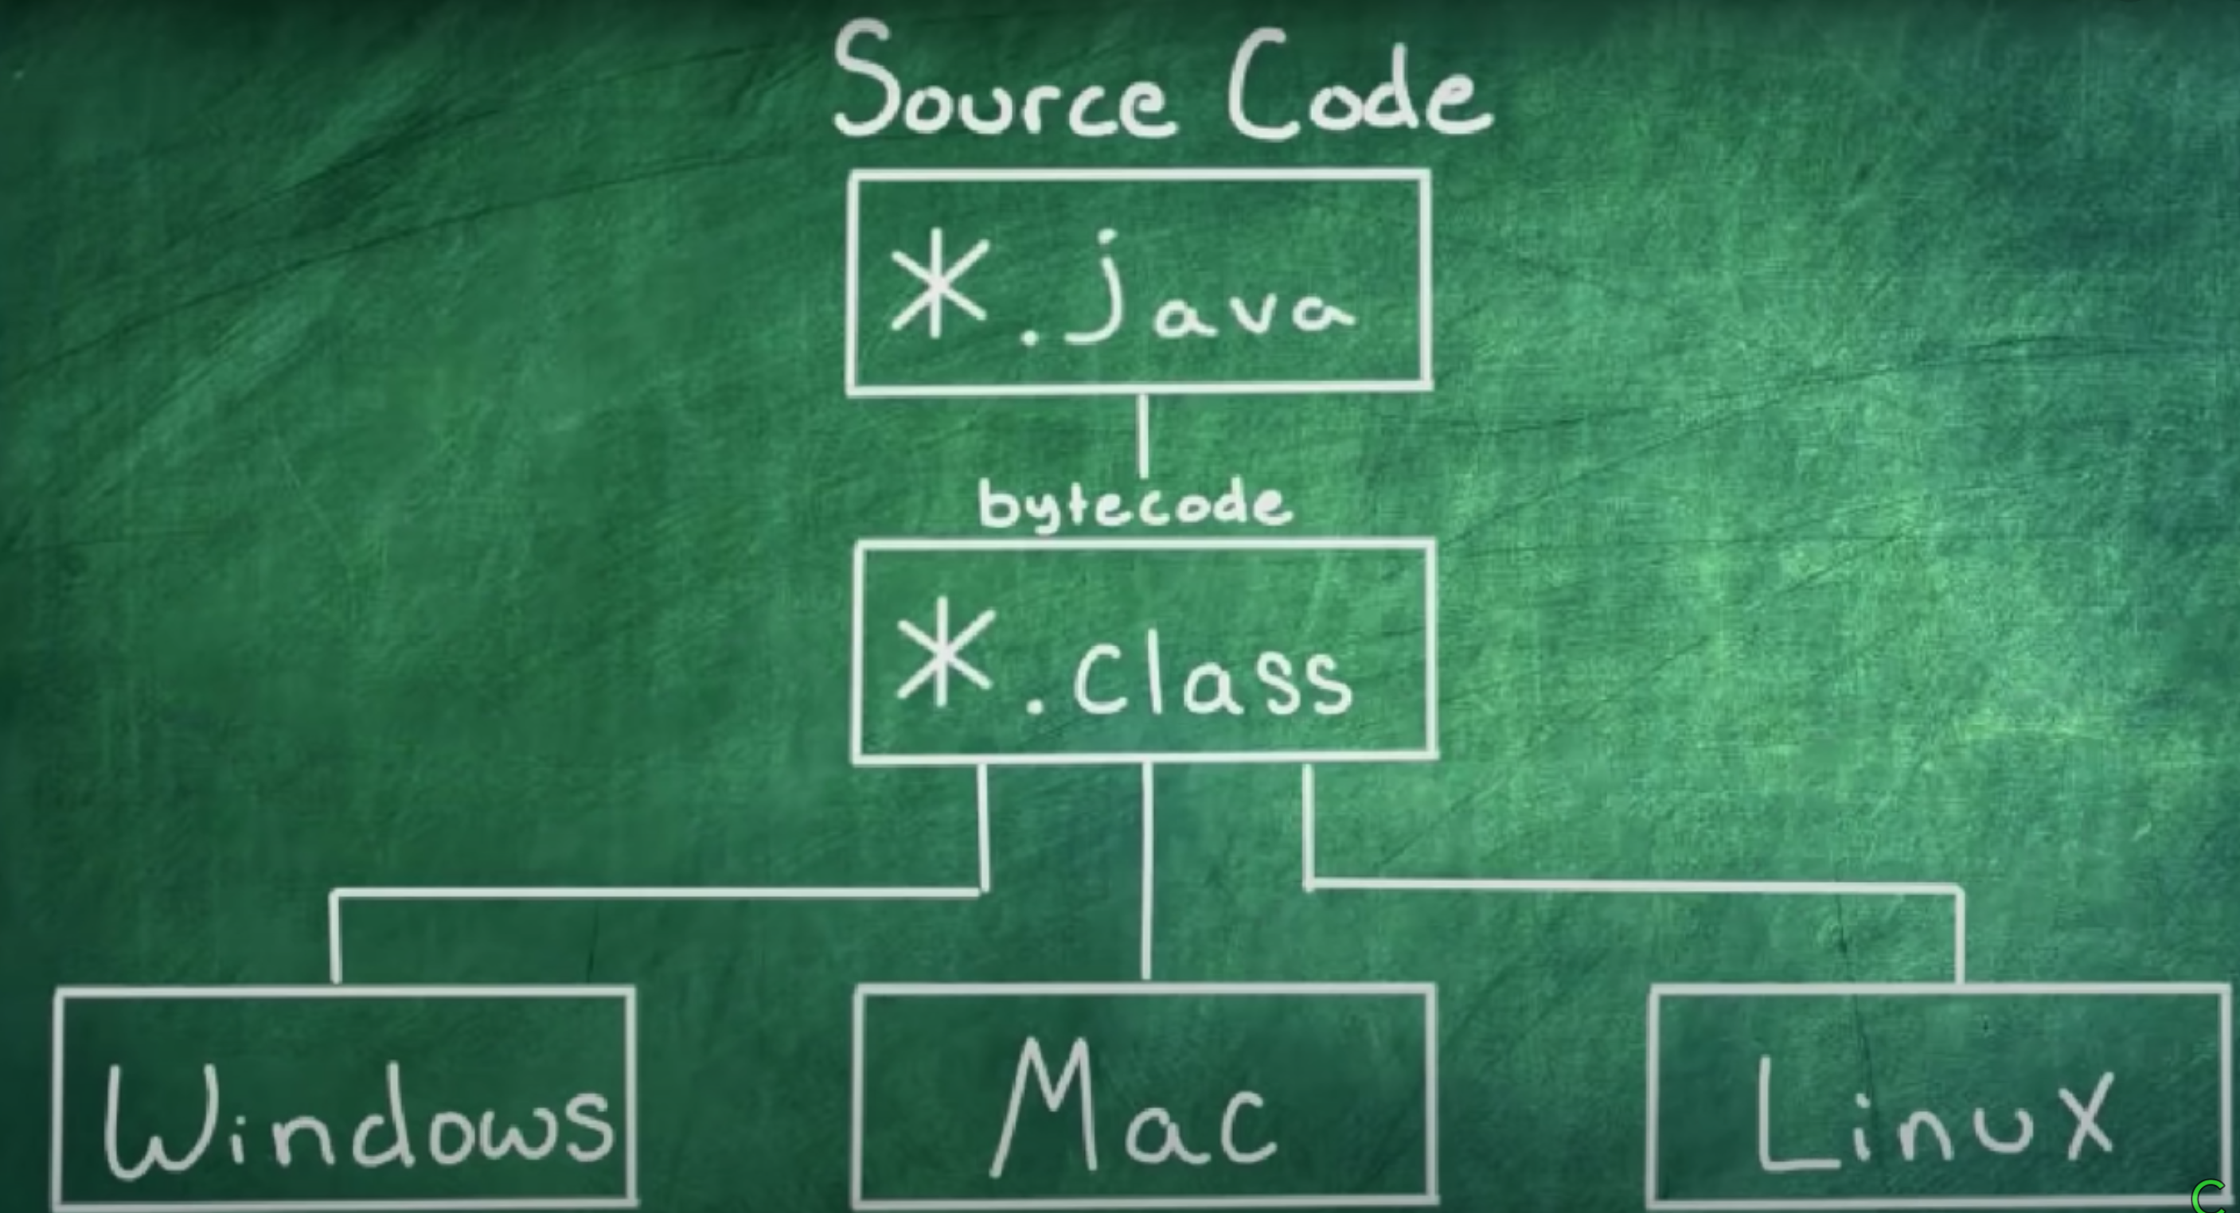
Java
High level, robust, secure, object- oriented language
Platform independent due to JVM(JAVA Virtual Machine)
Java Runtime Environment (JRE) is Java’s platform

Slide 24
Java
Setting up your development environment
installing the Java Development Kit, JDK
https://www.oracle.com/java/technologies/javase-jdk14-downloads.html
Installing IDE(Integrated Development Environment)
https://www.eclipse.org/downloads/

Slide 25
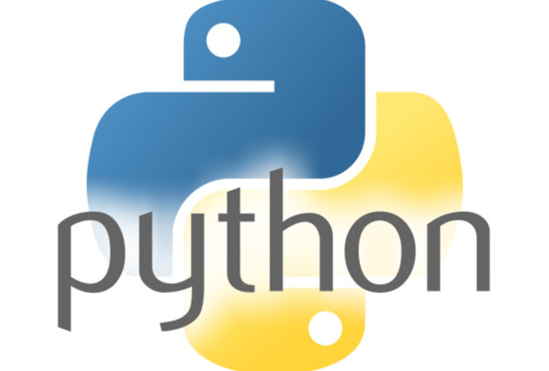
Python – what is it?
General purpose interpreted language
It is interactive
Object oriented and high-level programming language
Invented by Guido van Rossum in 1990

Slide 26
Spyder
Spyder is written completely in Python
It is designed by scientists and is exclusively for scientists, data analysts and engineers
Spyder is also know as Scientific Python Development IDE(Integrated development environment)
Installation(download Spyder with Anaconda)
https://www.anaconda.com/products/individual
Click on the Download option
Choose the version that is suitable for your computer and click on download
Complete the Setup and click on Finish
Launch Spyder From the Anaconda Navigator

